Slide 1


Presentation of the
WGMM
23 April 2026
Notes:
Tobi

Slide 2
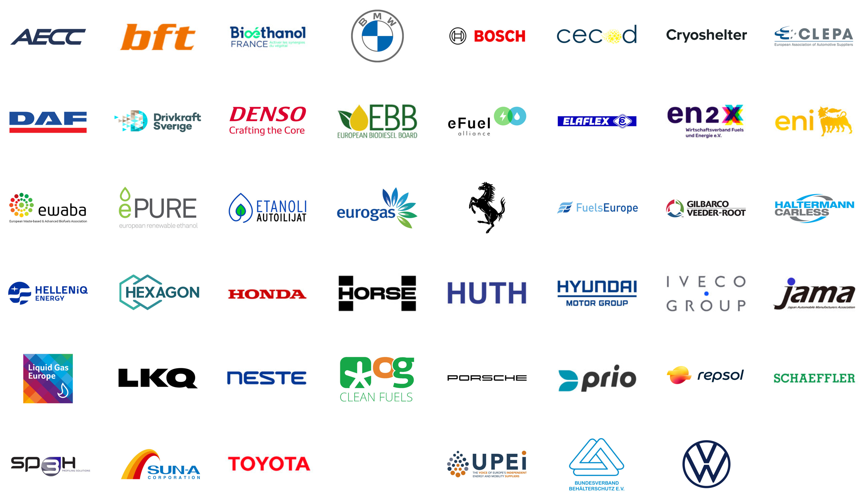


WGMM Members
…
Notes:
Alain

Slide 3

Key WGMM Facts
160+ people involved
50+ members
150+ meetings held
Notes:
Alain

Slide 4
Regulatory Background
Agreement on CO₂ Emission Standards for Heavy-Duty Vehicles, which include a vehicle class for all CO₂ neutral fuels – including biofuels
Presentation of the Automotive Package by the Commission
Review of the CO₂ emission standards for er Heavy-Duty Vehicles
First proposal from the Commission on the new vehicle class
Jul 2023
Feb 2024
16 Dec 2025
2027
Mar 2023
20ᵗʰ Sep 2023
11ᵗʰ Dec 2024
2026 (expected)
Compromise on CO₂ Emission Standards for Cars and Light-Duty Vehicles, which includes a new class for vehicles that are exclusively supplied with CO₂ neutral fuels
Establishment of the Working Group on Monitoring Methodologies in Stuttgart, Germany
WGMM General Assembly & Publication of the Report on 11 Monitoring Options
Review of the CO₂ emission standards for Light-Duty Vehicles
Delegated Act on EURO 7 for a new vehicle class
Impl. Act for type approval
Notes:
Alain

Slide 5
WGMM Definition of Eligible Fuels (VEEF)
“Eligible fuels” means all fuels defined by Directive (EU) 2018/2001, provided that they meet the sustainability criteria of that Directive and associated delegated acts, where the same amount of CO₂ from biomass, ambient air or recycled carbon sources is bound in the fuel production as is released during combustion in the use phase. Those fuels shall include renewable and/or synthetic fuels, such as biofuel, biogas, biomass fuel, renewable liquid and gaseous transport fuel of non-biological origin (RFNBO) or a recycled carbon fuel (RCF).
Notes:
Alain

Slide 6
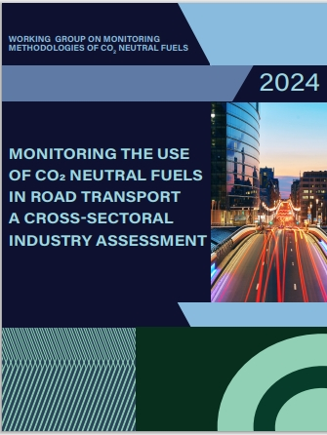
11 Monitoring Methodologies
11 technical options were evaluated and described in the WGMM Technical Report:
Option 1 – Mechanical adaption of tank filler / nozzle
Option 2 – Fuel Marker along upstream and downstream
Option 3 – Digital fuel tracking on upstream and downstream
Option 4 – Hybrid approach –fuel marker & digital handshake
Option 5 – Vehicle Onboard Fuel Detection Function
Option 6 – Vehicle Onboard Fuel Molecular Sensor
Option 7 – Communication between vehicle and filling station
Option 8 – EU market exclusively supplied with Eligible Fuels
Option 9 – Mass-Balanced supply to each VEEF.
Option 10 – Fuel Usage Balancing – FUB
Option 11 – Combined – Upstream: mass balancing – Downstream: digital handshake
Notes:
Alana

Slide 7
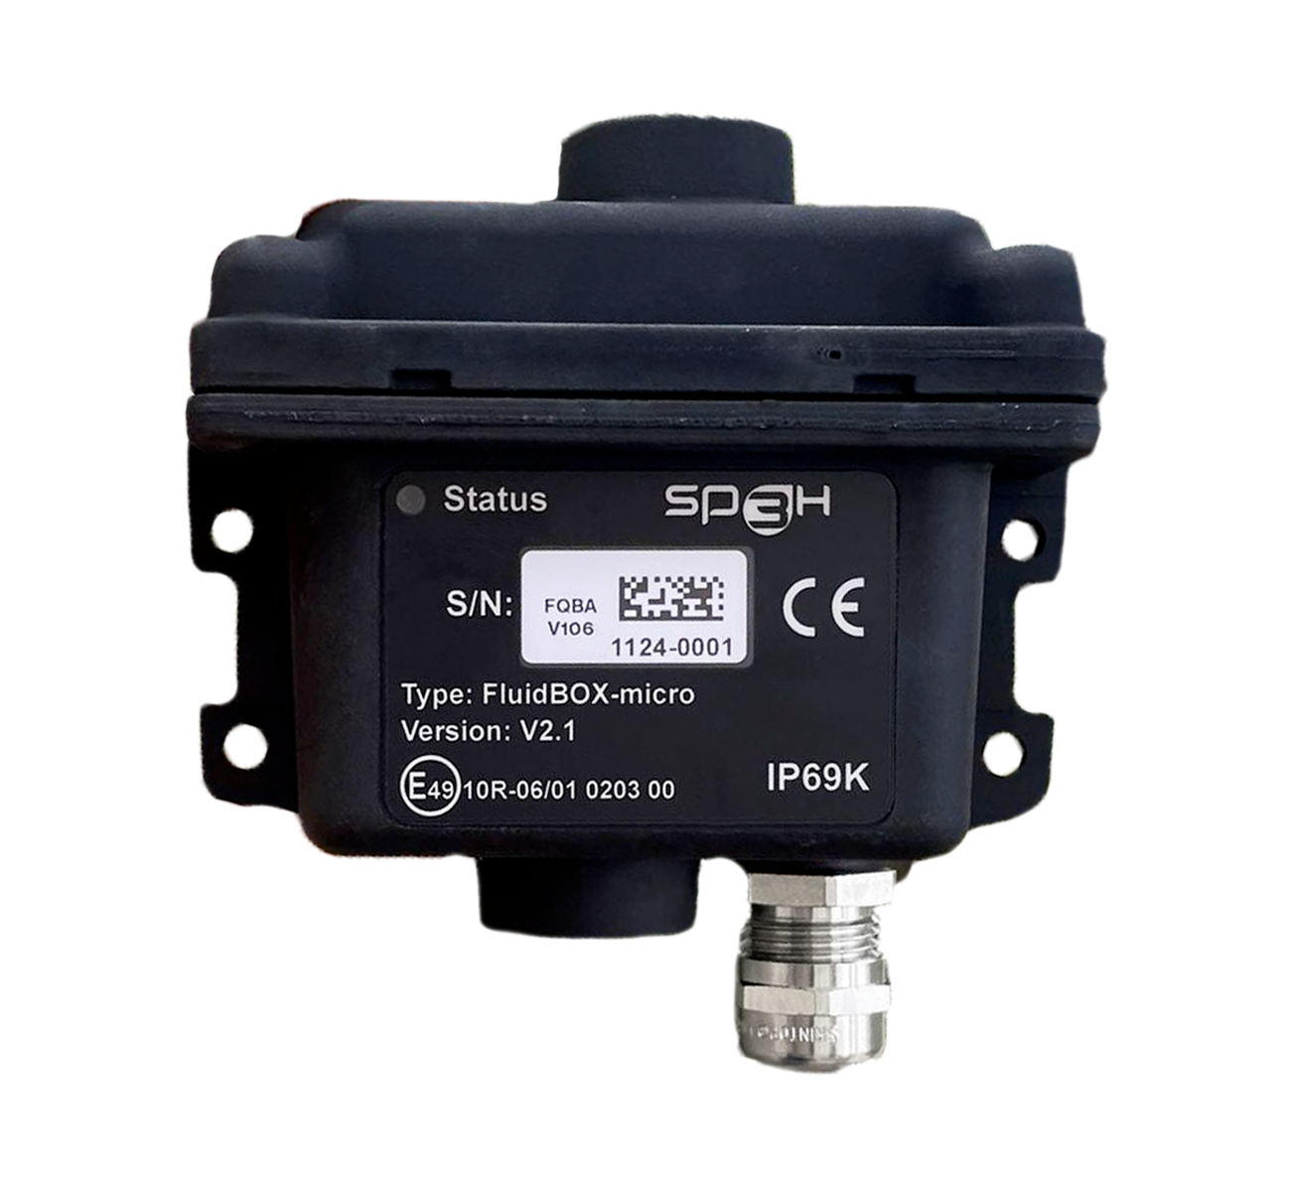

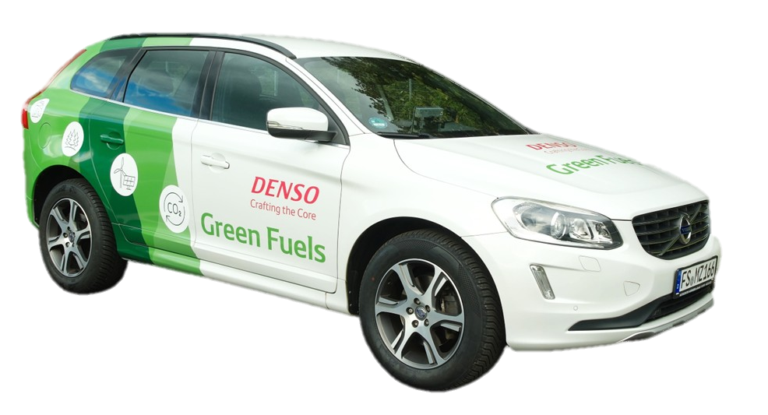
Examples of Use-Cases
Digital-Fuel-Twin-Technology from Bosch deployed during the Tour d‘Europe roadshow
FluidBox On-Board Sensor from SP3H
On-board Fuel Detection Function developed by DENSO
Notes:
Alana

Slide 8
Flexibility Mechanisms & Inducement Systems
1. Stop Vehicle Operations
2. Progressive Performance Reduction
3. Maximum Mileage Allowed
4. Financial Offsetting
a) At refuelling (surcharge)
b) During inspections (delayed fees)
Notes:
Alana

Slide 9
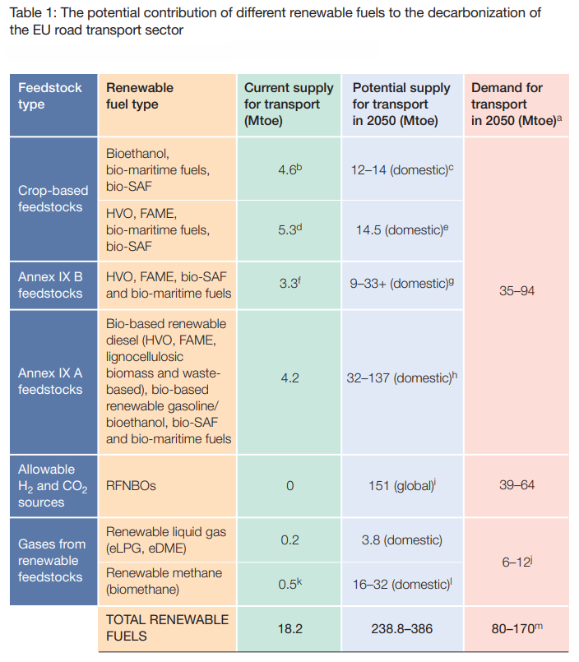
Feedstock Availability of CNFs
a Based on two potential demand scenarios: ‘Scenario 3’ for 2050 in the EU’s impact assessment on ‘Europe’s 2040 climate target and path to climate neutrality by 2050’, which foresees that renewable fuels will be utilised firstly in the maritime and aviation sectors with a supporting role in road transport, and the ‘More Molecule Scenario’ from the S&P Global study (2025) which demonstrates a higher ambition for renewable fuels by relaxing the requirements of the LDV and HDV vehicle standards and allowing sales of some new internal combustion engine cars and vans after 2035, and postponing any electrification in the aviation and marine sectors until after 2050.
b Source: ePURE, 2024.
c Source: ePURE (based on estimates of capacities and ethanol quotas via free trade agreements).
d Source: Shares and EBB 2024 statistical report.
e Source: EBB (based on European production capacities and imports via trade agreements).
f Source: Shares and EBB 2024 statistical report.
g For the Annex IX B feedstocks for FAME and HVO, we indicate a figure of 33 Mtoe+ for the potential supply for transport, but intermediate crops can count in both Annex IX A and B. The potential for intermediate crops (indicated by the ‘+’) is based on a European Commission study undertaken in 2024.
h Source: Concawe/Imperial College London, 2021.
i Estimated availability for the EU from global e-fuel/RFNBO availability. Source: Porsche Consulting, 2024.
j The demand for renewable methane for transport in 2050 is derived from the Eurogas 2050 scenario, assuming that 10% of the HDV fleet would be powered by renewable methane.
k Source: Shares.
l Potential production in 2050 = 165 bcm = 142 Mtoe, of which the share attributed to transport is 23% (current share of biomethane for transport). Source: Gas For Climate study, 2022. Available at: https://gasforclimate2050.eu/wpcontent/uploads/2023/12/Guidehouse_GfC_report_design_final_v3.pdf
Notes:
Alain

Slide 10

Thank you!
alain.mathuren@fuelseurope.eu
Please visit us at www.wgmm.eu
Feel free to explore our work by scanning the QR code below:
Notes:
Alain, Alana, Tobi

